Slide 1

Financial Accounting
Dr. Smita Jape
Associate Professor,DR.V.N.BRIMS

Slide 2
LEARNING OBJECTIVES
1. Define accounting, identify business goals and activities, and describe the role of accounting in making informed decisions.
2. Identify the many users of accounting information in society.
3. Explain the importance of business transactions, money measure, and separate entity to accounting measurement.
4. Describe the corporate form of business organization.

Slide 3
List of online Database available :
1. *CRISIL Research
2. Ebscohost : Business Source premier
Database
3. JSTORE
4. * ACE Equity
5. CMIE Prowess
6. J- Gate
7. ERIC

Slide 4
Accounting provides a vital service by supplying the information decision makers need to make reasoned choices among alternative uses of scarce resources in the conduct of business and economic activities.

Slide 5
Accounting is a link between business activities and decision makers.
  Accounting measures business activities by recording data about them for future use.
  The data are stored until needed and then processed to become useful information.

Slide 6
Business Goals
  1. Profitability.
  A business must take in enough money
  to pay all the costs of doing business, with
  enough left over as profit for the owners
  to want to stay in business.
  2. Liquidity.
  A business must have enough cash available to pay debts when they are due.

Slide 7
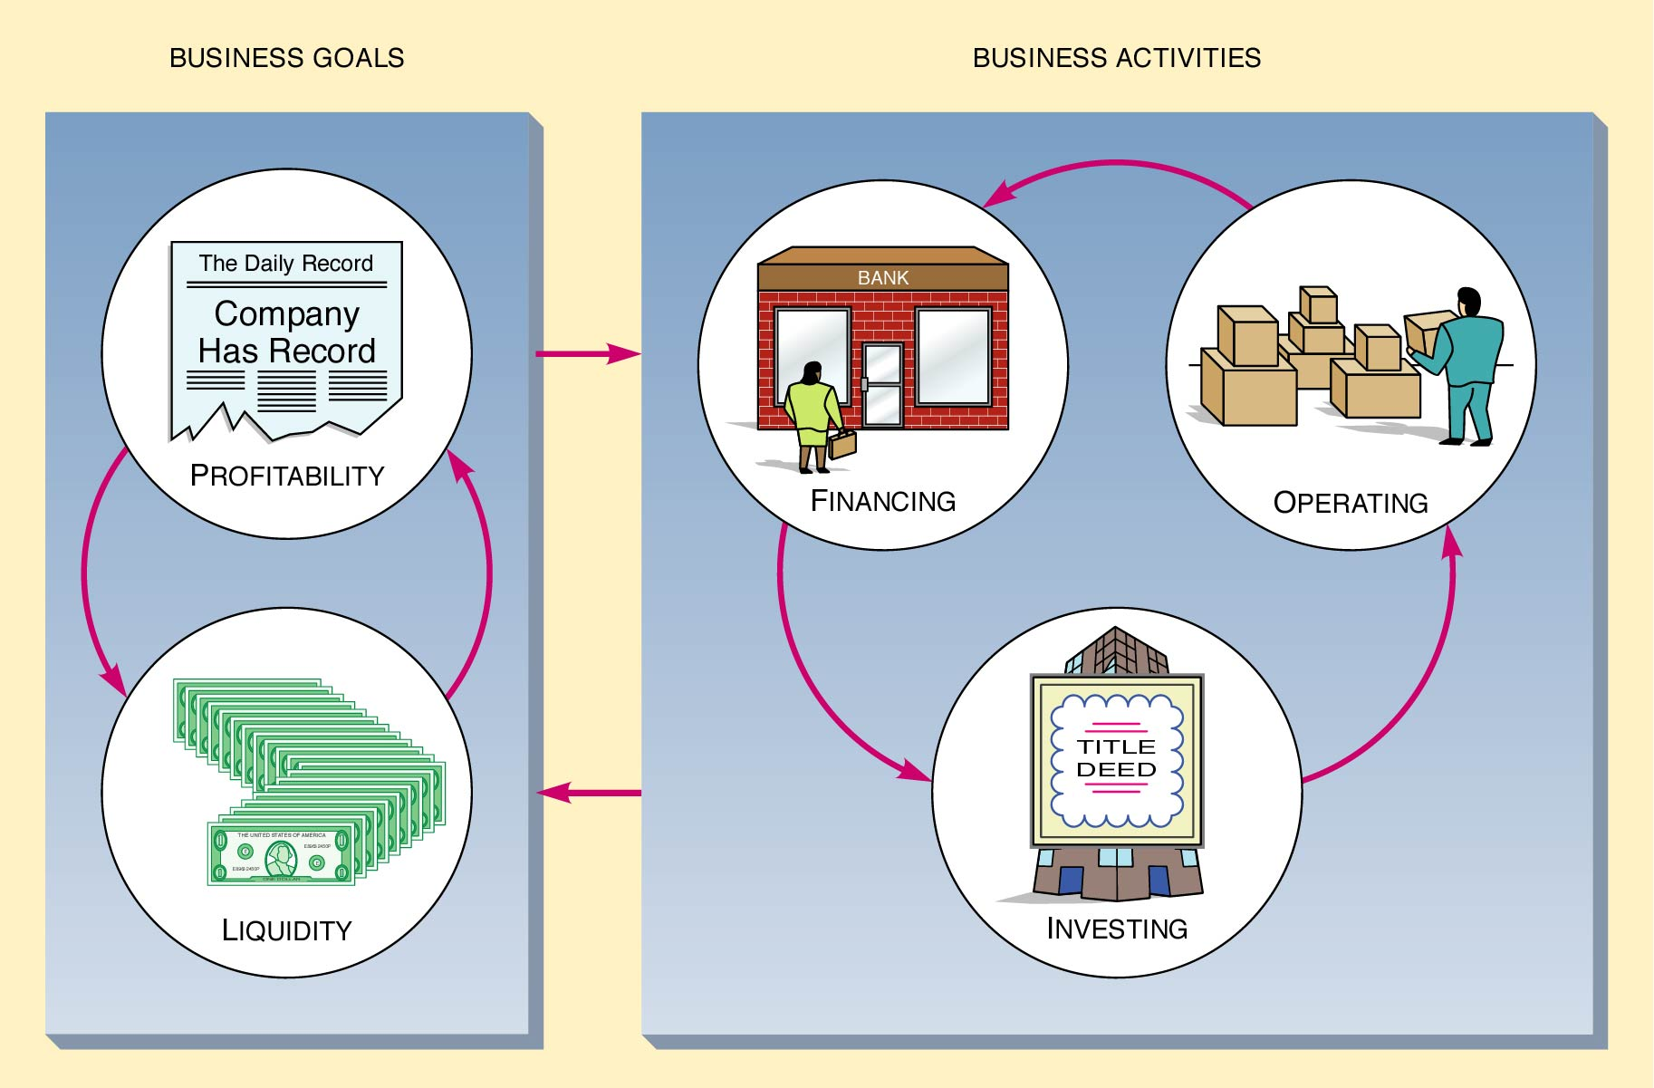
Business Goals and Activities

Slide 8
Business Activities
  1. Financing Activities.
    Obtaining capital from owners and creditors.
    Repaying creditors and a return to owners.
  2. Investing Activities.
    Spending the capital it receives in ways that are productive and will help the business achieve its objectives.
    Buying and selling assets to be used in the business.

Slide 9
Business Activities (continued)
  3. Operating Activities.
    Selling of goods and services to customers.
    Employing managers and workers, buying and producing goods and services, and paying taxes.

Slide 10
Financial and Management Accounting
Accounting’s role of assisting decision makers by measuring, processing, and communicating information is usually divided into two categories:
1. Management accounting.
2. Financial accounting.
The two may be distinguished by the principal users of their information.

Slide 11
Management Accounting
Is oriented toward the needs of internal decision makers.
Provides managers and employees with information regarding how they have done in the past and what they can expect in the future.

Slide 12
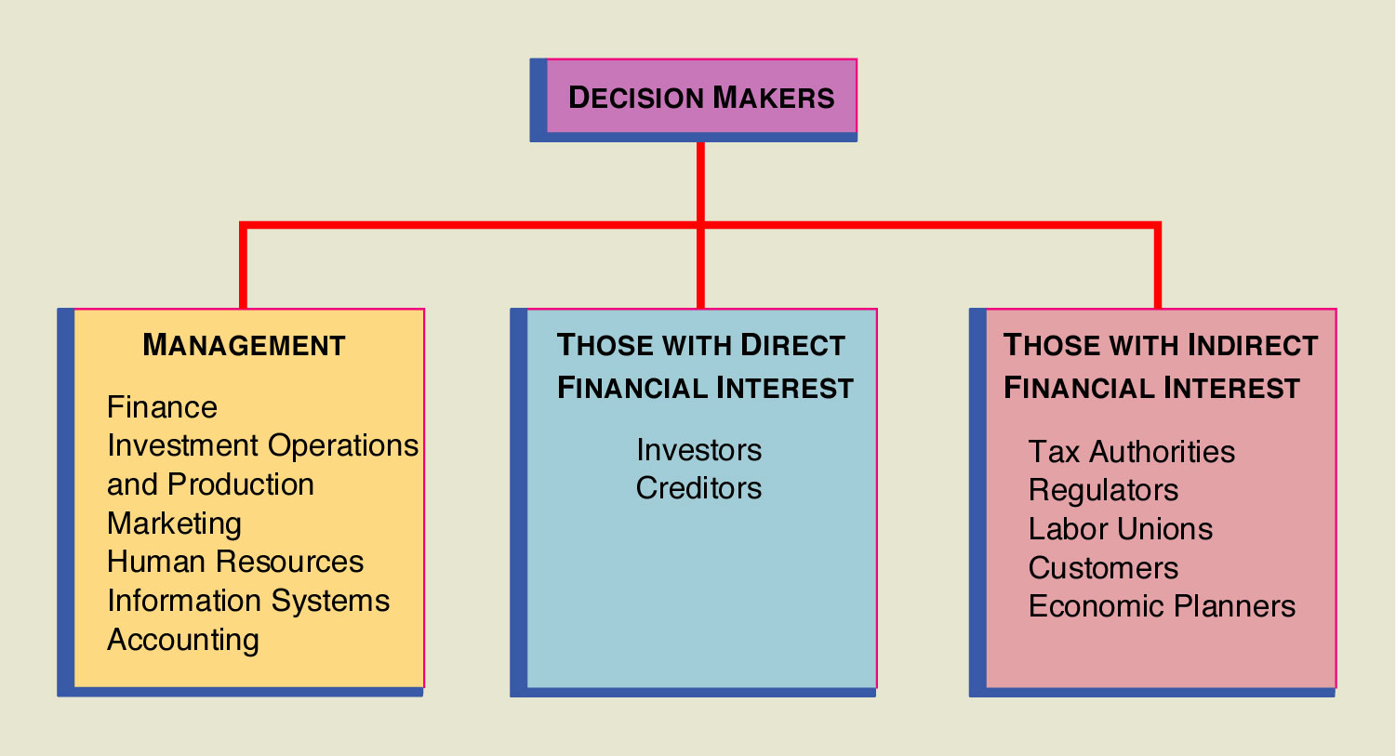
The Users of Accounting Information

Slide 13
Outside Users with a Direct Financial Interest
Investors
Creditors

Slide 14
People, Organizations, and Agencies with an Indirect Financial Interest
Tax Authorities.
Regulatory Agencies.
Labor Unions.
Customers.
Economic Planners.

Slide 15
What Is Measured?
Business transactions as the object of measurement.
Business transactions are economic events that effect the financial position of a business entity.
  Transactions are the raw material of accounting reports.
  Transactions must relate directly to a business entity.

Slide 16
Money Measure.
  Money is the only factor common to all business transactions.
  The monetary unit a business uses depends on the country in which the business resides.
  Exchange rates translate one currency to another.
The Concept of Separate Entity.
  A business is a separate entity, distinct from its creditors and customers and from its owner or owners.

Slide 17
Types of Business Organization
Sole Proprietorship.
Partnership.
Joint Stock company: Pvt Ltd /Public Ltd
Cooperative Organisations
Govt: Govt dept/Public corporations/ Government company

Slide 18
Assets
Assets are economic resources owned by a business that are expected to benefit future operations.
  Monetary items.
  Nonmonetary physical things.

Slide 19
Liabilities
Liabilities are the present obligations of a business to pay cash, transfer assets, or provide services to other entities in the future.

Slide 20
Owners’ Equity
Owners’ equity represents the claims by the owners of a business to the assets of the business.
Owners’ equity is the residual equity that remains after deducting liabilities from assets.
OE = Assets - Liabilities.
Assets = Liabilities + SE.
SE = Contributed Capital + Retained Earnings.

Slide 21
Accounting Concepts
Accrual Concept-Income and expenses should be recognized as and when incurred irrespective of whether money is recd or paid
Matching :Income=Revenue-expenses
Dual Aspect concept—Every business transaction has dual effect
Going Concern—Business has indefinite life
Money Measurement—
Accounting Period

Slide 22
Accounting Conventions
Consistency—Accounting treatment (depreciation /inventories)
Full Disclosure
Conservatism-
Materiality

